Slide 1
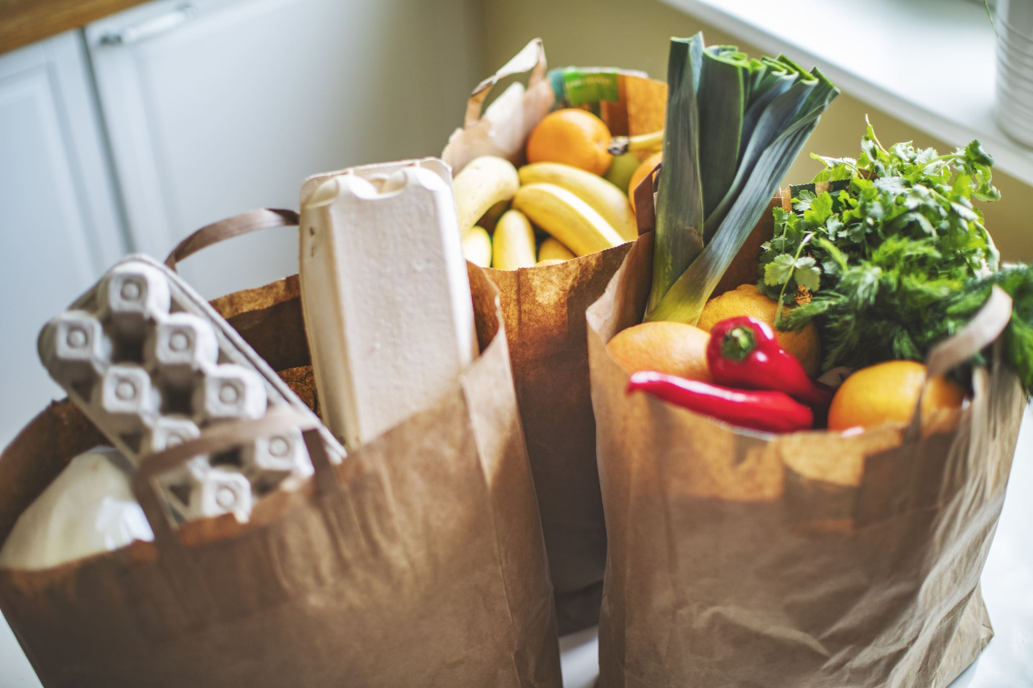
Mobile International Grocery Store
Tagline: “Your Home Across Borders”
Team Members: Brave Madeya
Manakdeep Kaur
Daniel Nii Nortey Saba

Slide 2
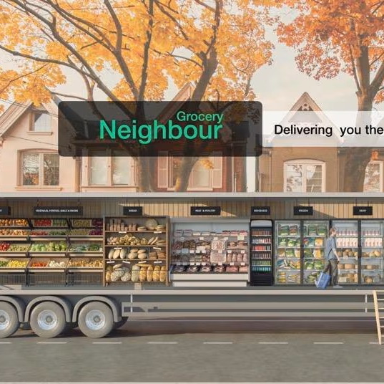
Product/Service Overview
Grocery truck.
Fresh & packaged products from Asia, Africa, Europe, Latin America.
Weekly rotating schedule across 6 neighborhoods.
Convenient hours: 11:00 a.m. – 8:00 p.m.

Slide 3
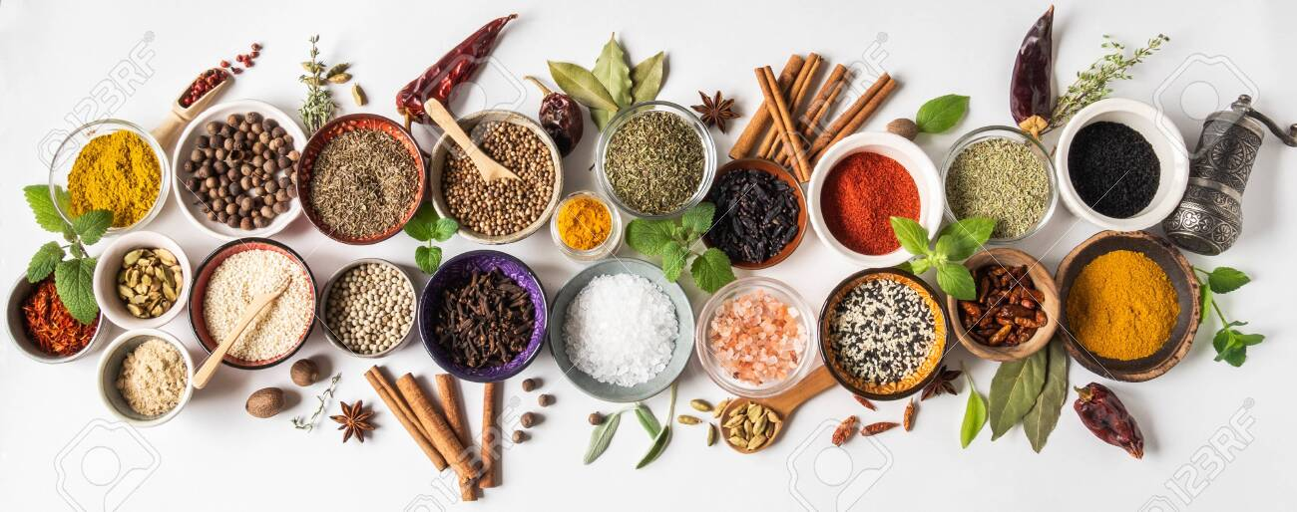
Features & Benefits
Extensive Selection: Rare spices, sauces, cheeses.
Convenience: Grocery truck visits neighborhoods, saves time & travel.
Affordable Pricing: Lower overhead → lower prices than specialty stores.
Flexible Inventory: Seasonal products for cultural festivals.
Freshness & Reliability: Consistent weekly schedule.

Slide 4

Unique Selling Proposition (USP)
Combines mobility, variety, and affordability.
Fixed stores: limited selection & expensive.
Online stores: high shipping costs, slow delivery.
Truck also acts as a community hub → cultural exchange & social ties.

Slide 5
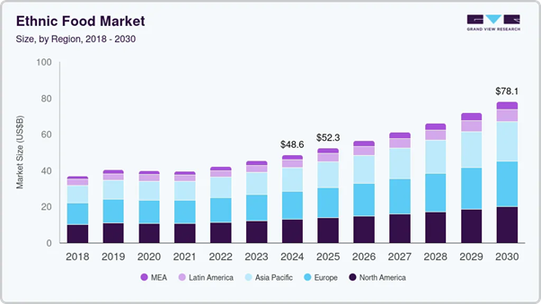
Industry Overview
Ethnic food market is growing globally & in the U.S.
Global market: $48.6B (2024) → $78.1B (2030), CAGR 8.3%.
U.S. market: $29.2B (2024) → CAGR 7.3% through 2033.
Driven by multicultural populations & fusion cuisine trends.

Slide 6

Target Market
Primary: Immigrant families seeking authentic ingredients.
Secondary: Students, food lovers, and local residents exploring cuisines.
Millennials & Gen Z driving demand via social media & urban lifestyle.

Slide 7

Market Trends & Opportunities
E-commerce & online delivery increase accessibility.
Consumers value health, natural ingredients, and cultural authenticity.
Tech & automation improve logistics & delivery efficiency.
Regulatory & tariff challenges impact supply chain.

Slide 8
Competitor Analysis
Competitor | Strengths | Weaknesses
Amazon Fresh | Fast delivery, broad inventory | Lacks ethnic variety, Prime-only
Walmart+ | Nationwide, low price | Minimal ethnic offerings
Instacart | Local partnerships | Variable pricing & availability
HelloFresh | High-quality, convenient | Limited variety
Ethnic Supermarkets | Authentic, community ties | Small scale, limited delivery
Opportunity: Mobile International Grocery Store combines authenticity, mobility and affordability.

Slide 9

SWOT Analysis
Strengths: Authentic ingredients, mobile access, affordable pricing.
Weaknesses: Start-up coordination, initial investment.
Opportunities: Cross-cultural flavors, growing multicultural market.
Threats: Supply chain delays, tariffs, regulations.

Slide 10

Branding
Logo: Vibrant colors (black olives, turmeric, olive green), modern icons, in a bowl → diversity & unity.
Slogan: “Your Home Across Borders”
Truck exterior, product packaging & app design reflect branding.

Slide 11

Marketing Channels
Social Media: Instagram, TikTok, Facebook, X.
Digital Ads: Google search + predictive targeting.
Email/SMS: Route updates & promotions.
Digital Flyers: Highlight weekly specials.
Channels chosen for high engagement with target audience.

Slide 12

Pricing Strategy
Value-based pricing: Reflects convenience, authenticity, cultural significance.
Standard items: $2–$8.
Premium items: $10–$20.
Bundles: “Taste of Asia” $25 / “Latin American Essentials” $30.
Prices lower than specialty stores, more authentic than mainstream.

Slide 13

Sales Channels & Retention
Mobile van: Rotating route for neighborhood access.
Online platform: Product browsing, pre-order & pickup.
Social media updates: Route + inventory notifications.
Customer retention: Consistent schedule, face-to-face interaction, loyalty program.

Slide 14
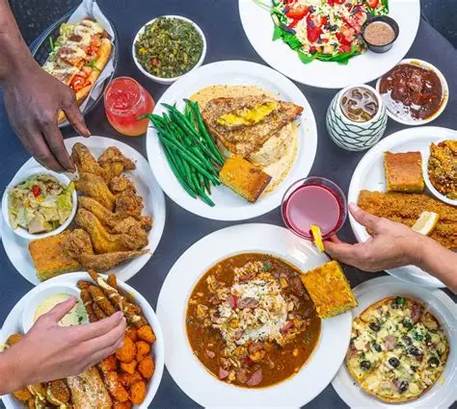
Video Appeal Explanation
Highlights authenticity & convenience.
Shows cultural diversity & community connection.
Appeals to immigrant families, students, and food lovers.
Encourages first-time visits & repeat customers.

Slide 15

Promo Video

Slide 16
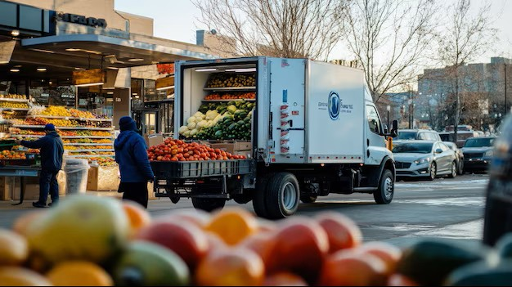
Conclusion
Value Proposition: Mobile International Grocery Store delivers affordable, authentic global groceries directly to neighborhoods.
Builds community, cultural exchange, and culinary discovery.

Slide 17
References
Elain Paulson-Box Peter Williamson, (1990). The Development of Ethnic Food in the UK, British Journal. https://www.scribd.com/document/463601714/10-1108-00070709010141460-pdf
Ethnic Food Market (2025-2030). (2024, June 23). Grand View Research. https://www.grandviewresearch.com/industry-analysis/ethnic-food-market-report
Food Processing and Processed Food. (2025, October 06). Fortune Business Insight. https://www.fortunebusinessinsights.com/ethnic-foods-market-102264
Food Technology Market. (2025, January). Global Market Insights. https://www.gminsights.com/
Meenakshi Bisht (2024, December). USA Ethnic Food Market Outlook to 2030. Ken Research. https://www.kenresearch.com/industry-reports/usa-ethnic-food-market
Online grocery market size and share | Industry report, 2033. (n.d.). Grand View Research. https://www.grandviewresearch.com
Online grocery market size, share & 2030 trends report. (2025). Mordor Intelligence. https://www.mordorintelligence.com
Online grocery delivery services market growth analysis: Size and forecast 2025–2029. (2025). Technavio. https://www.technavio.com
Online grocery delivery services market size, share, growth report, 2034. (2025). Zion Market Research. https://www.zionmarketresearch.com
What is Import and Export Logistics? Difference and Specifications. (n.d.).VS Global. https://vsglobal.co.in/import-and-export-logistics/

Slide 18
References
Tokinomo. (2023, July 10). The evolution of the ethnic food aisle: How cultural diversity shapes grocery retail. https://www.tokinomo.com/blog/retail-ethnic-food-aisle
Swhartley (2021, October 20) Global cuisine in the supermarket. Kerin Marketing. https://kerinmarketing.com/2021/10/20/global-cuisine-in-the-supermarket/?utm_source
Nicotela (2021, September 7) The Ethnic food aisle, Tokinomo. https://www.tokinomo.com/blog/retail-ethnic-food-aisle?utm_source
Grand View Research (2025). Ethic Food Market (2025-2030).Grand view research. https://www.grandviewresearch.com/industry-analysis/ethnic-food-market-report
Valerie Le (August 2025). Ethnic Supermarkets in US – Market Research Report (2015-2030). IBISWorld. https://www.ibisworld.com/united-states/industry/ethnic-supermarkets/4333/
Imarc (2025). United States ethnic foods market. Imarc. https://www.imarcgroup.com/united-states-ethnic-foods-market?utm_source
Savory Ethnic Foods (2015, December 14). Mccormickfona. https://www.mccormickfona.com/articles/2015/12/savory-ethnic-foods
Pew Research Center. https://www.pewresearch.org/internet/fact-sheet/social-media/

Slide 19
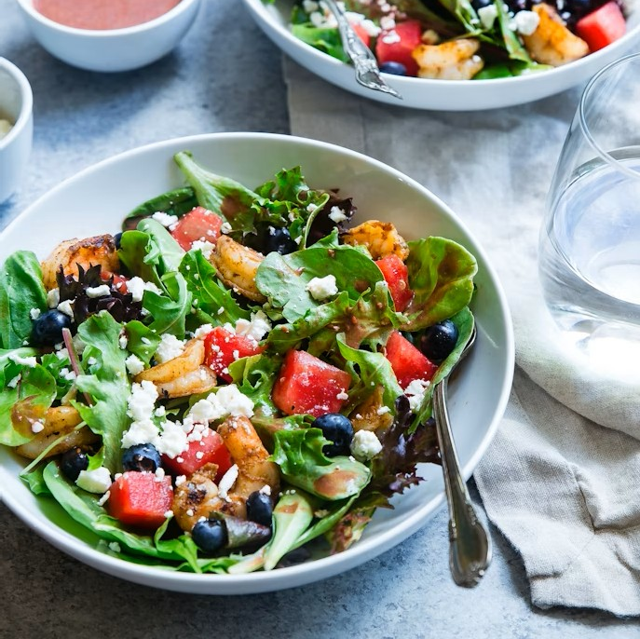
THANK YOU

